Slide 1
ISTQB Foundation level Exam Pattern

Slide 2
The Foundation Level exam is characterized by:
40 multiple-choice questions – There is no negative marking in the exam
a scoring of 1 point for each correct answer
a pass mark of 65% (26 or more points)
a duration of 60 minutes (or 75 minutes for candidates taking exams that are not in their native or local language).
Exam questions are distributed across K-levels, which represent deepening levels of knowledge

Slide 3
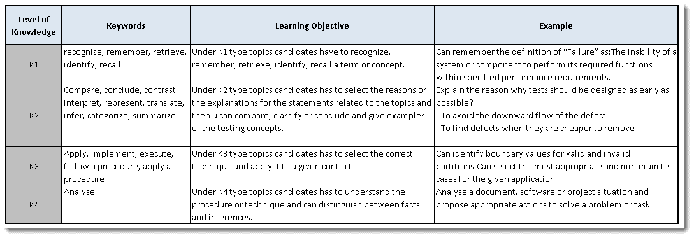
K Levels in ISTQB

Slide 4
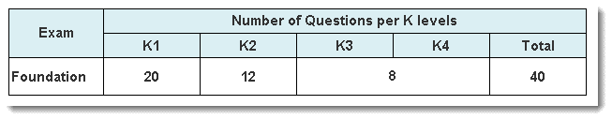
K levels

Slide 5
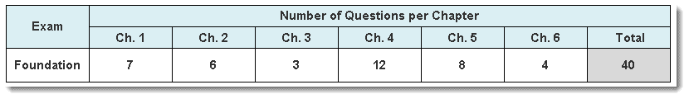
Chapter wise K Levels

